Slide 1
Pet Best LLC
IT Solution

Slide 2
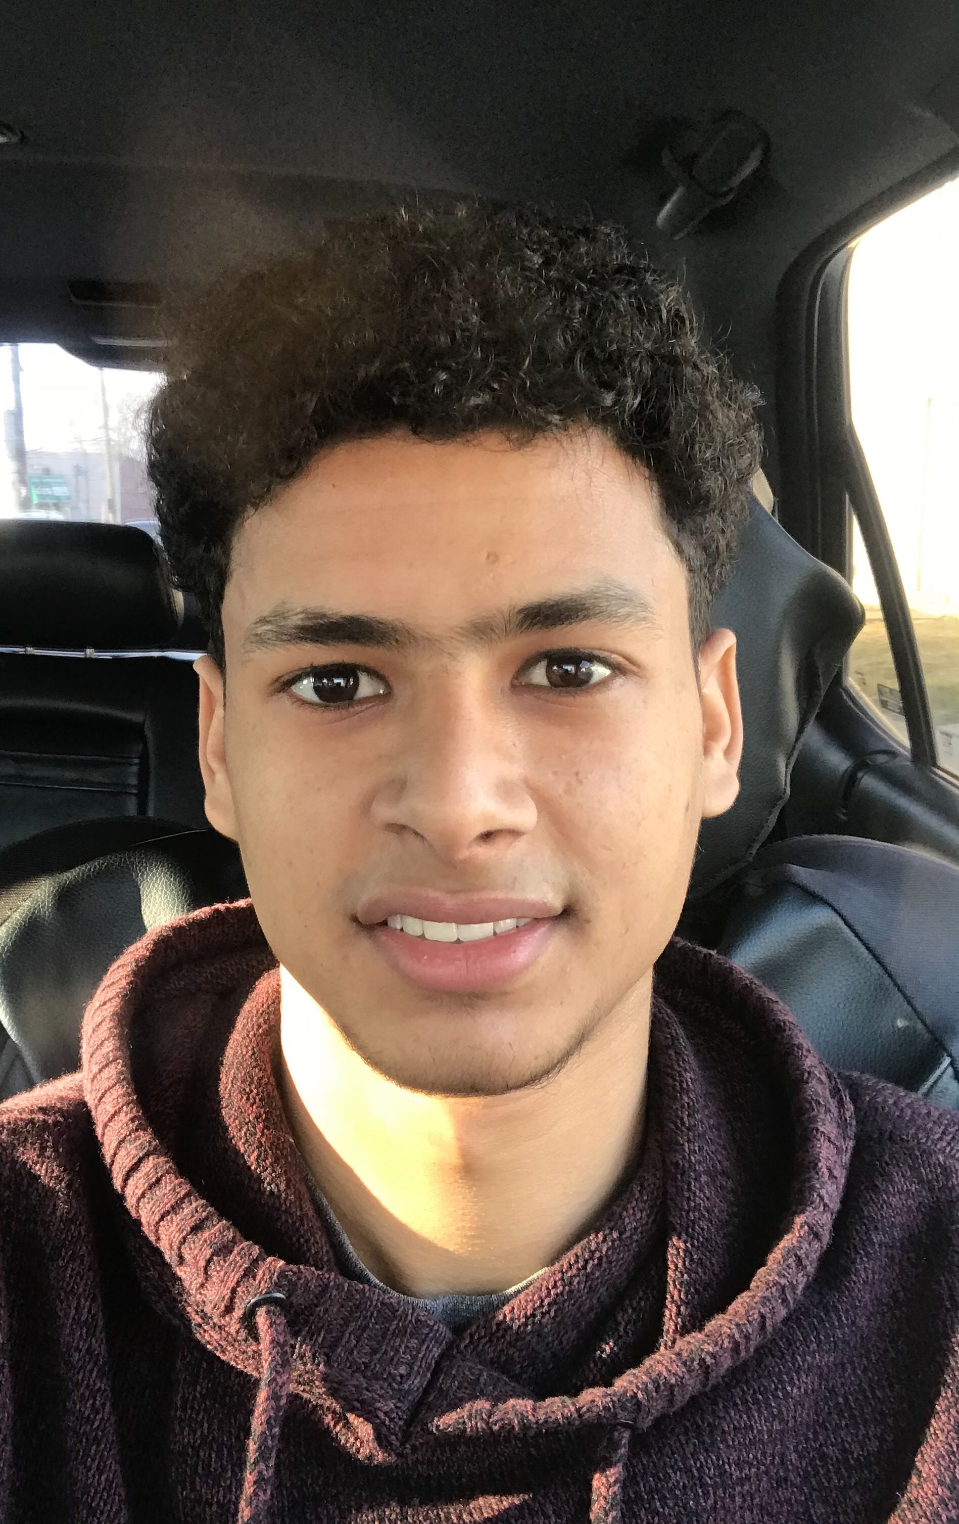

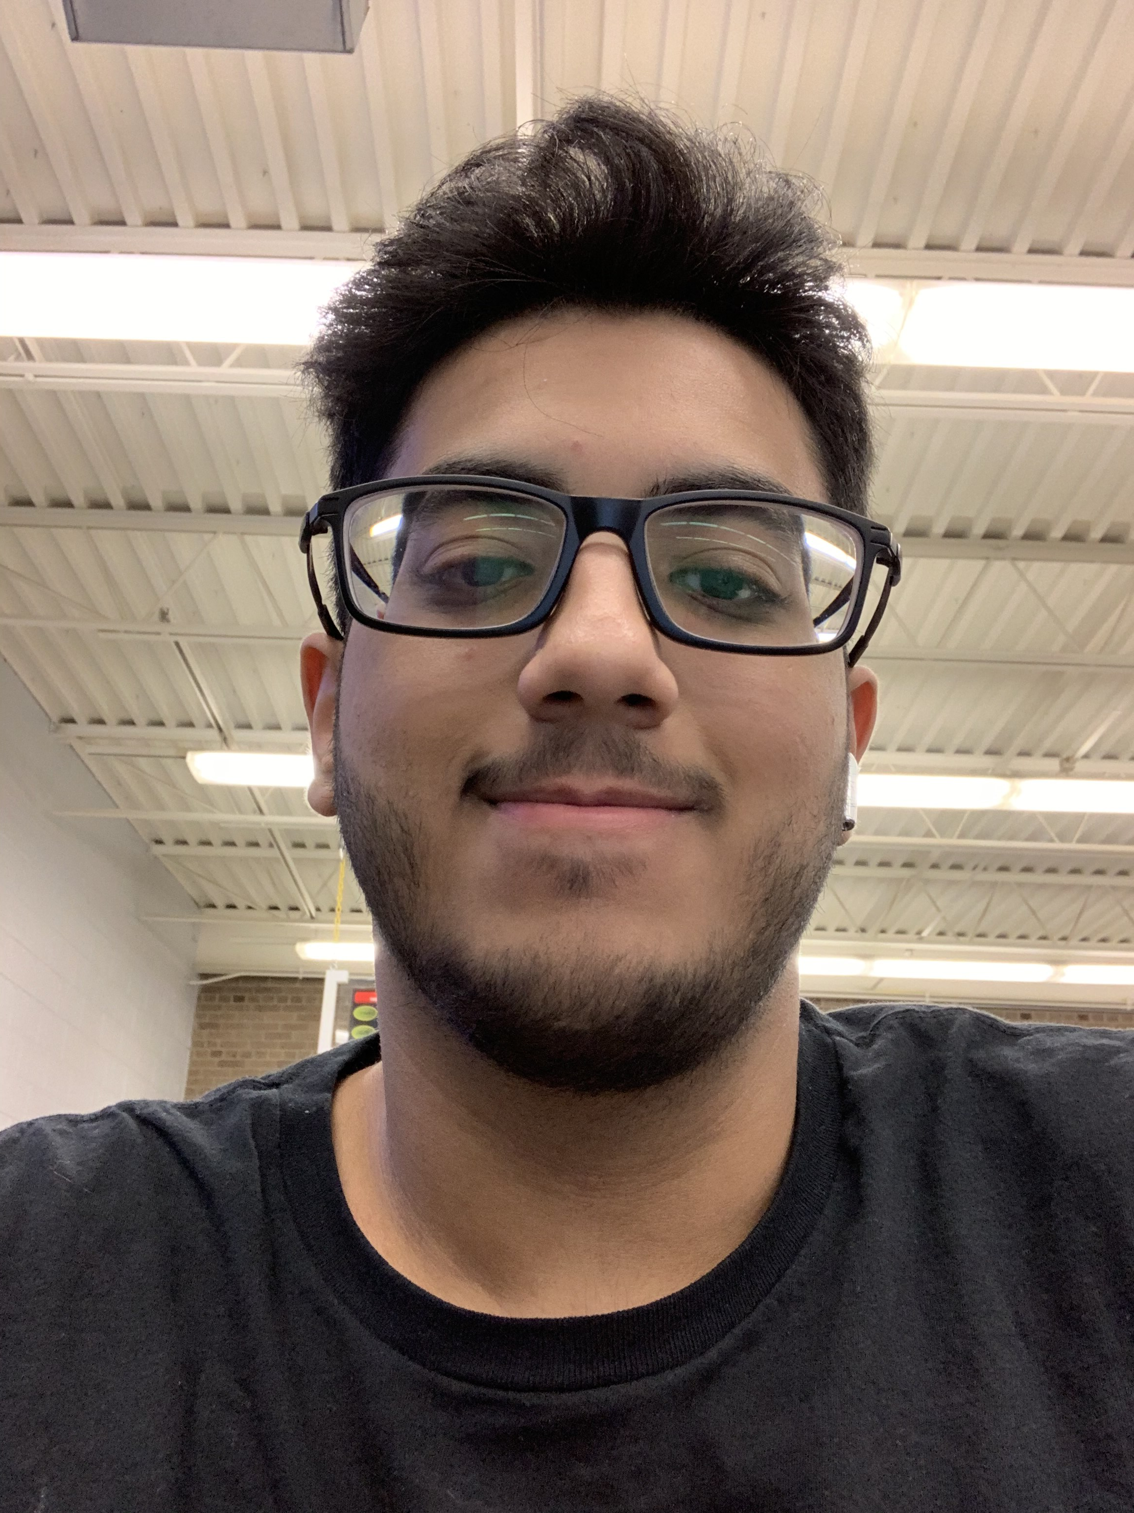
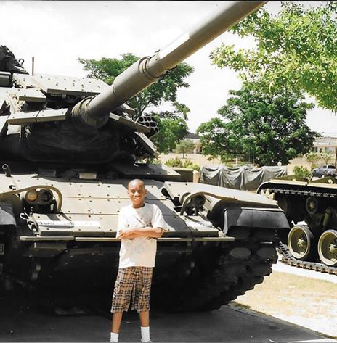



Meet the Team – Front End
Mohammed
Melody
Ahmad
Brandon
Sameha
Our mission is to help the customer bring in more business with a professional and responsive website.

Slide 3
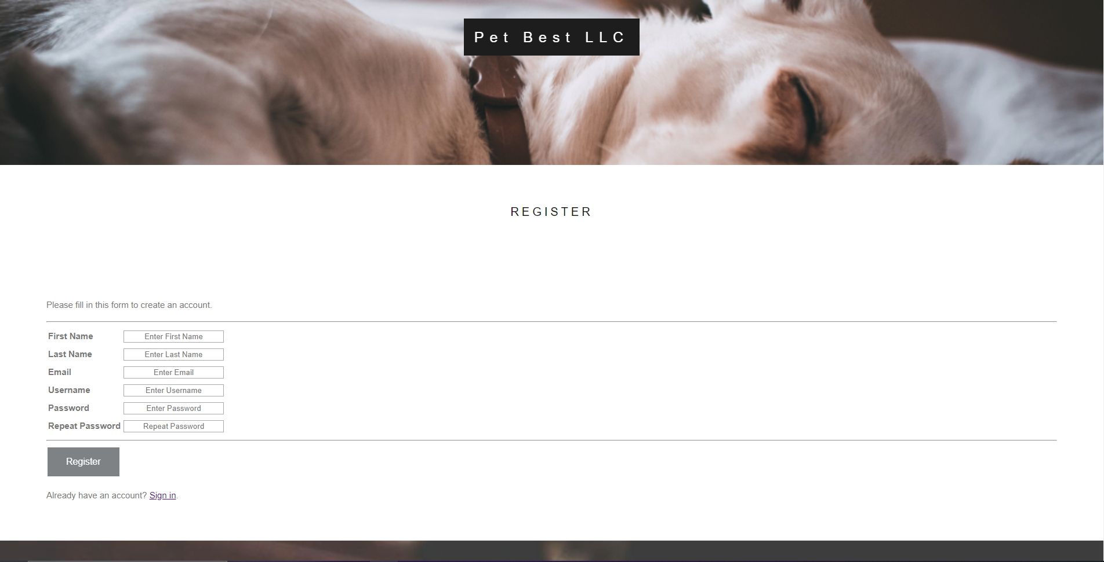
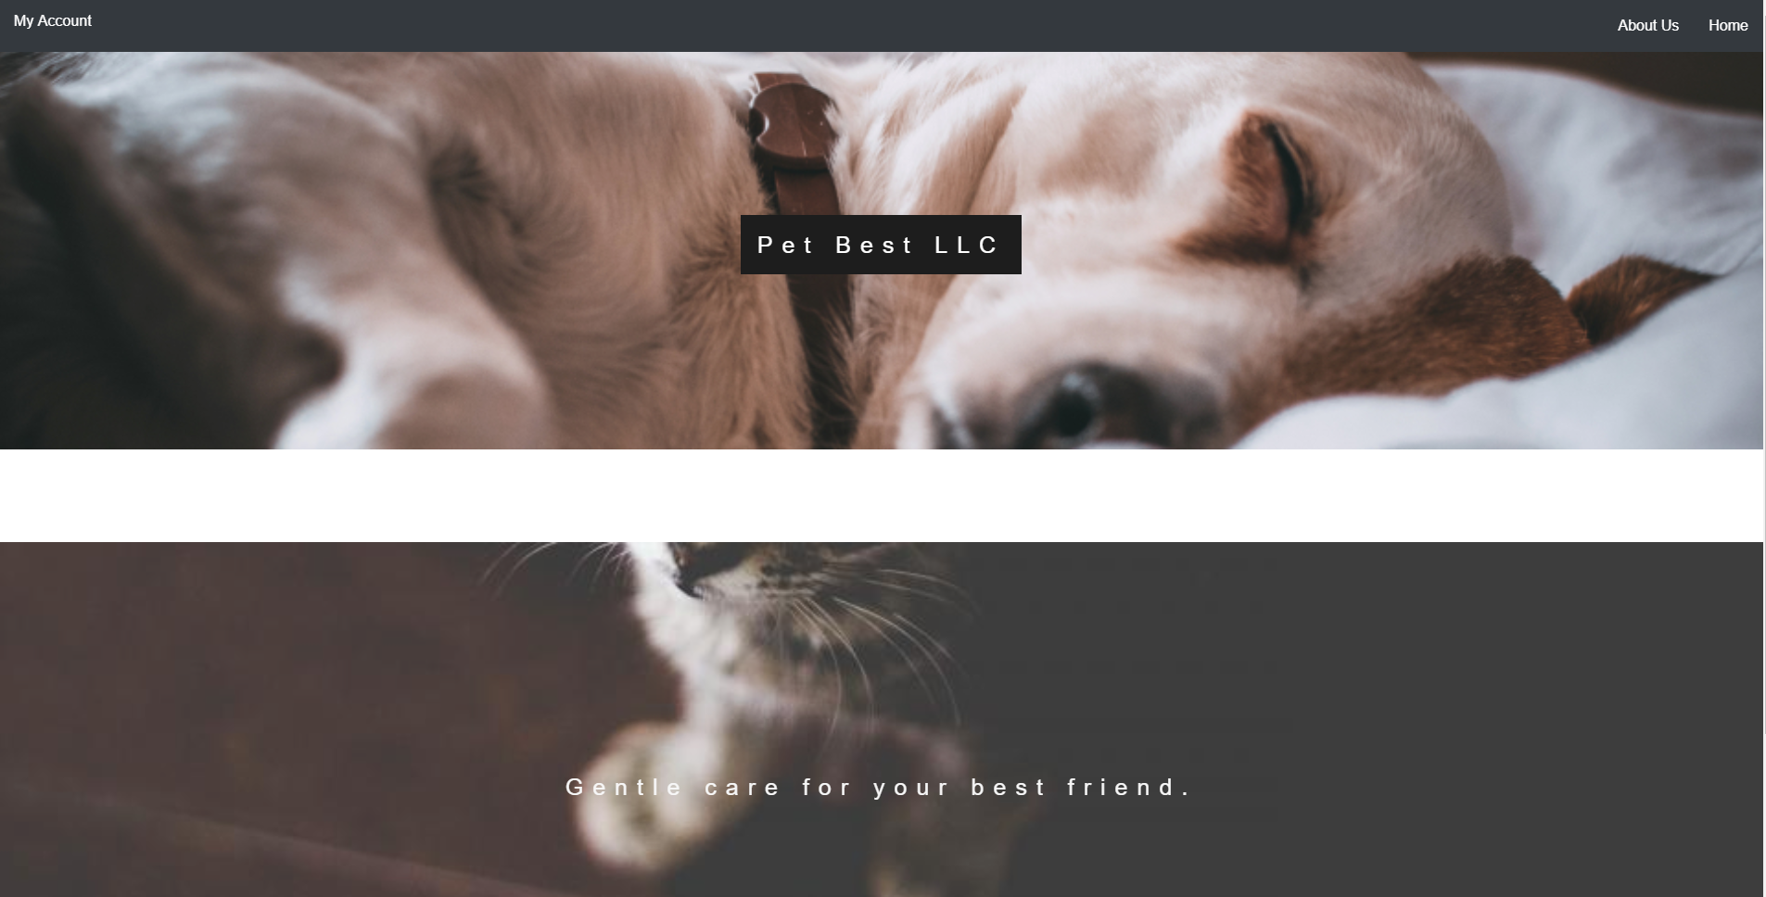
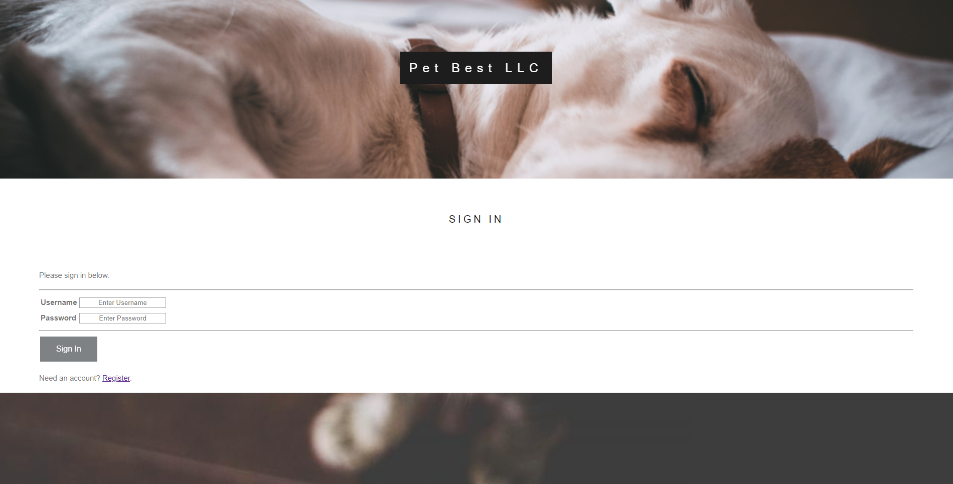
Services We Provide
Create numerous web pages that has a unique design for Pet Best
Respond to client needs and wants regarding design
Make sure overall appearance is well assessed and visually appealing

Slide 4
Home Screen
Nice simple design, with a parallax effect
Allows access to features like My Account page, About Us, etc.

Slide 5
Sign In and Register Page
Here the customer will be asked to sign in.
Don't have an account? Register!

Slide 6
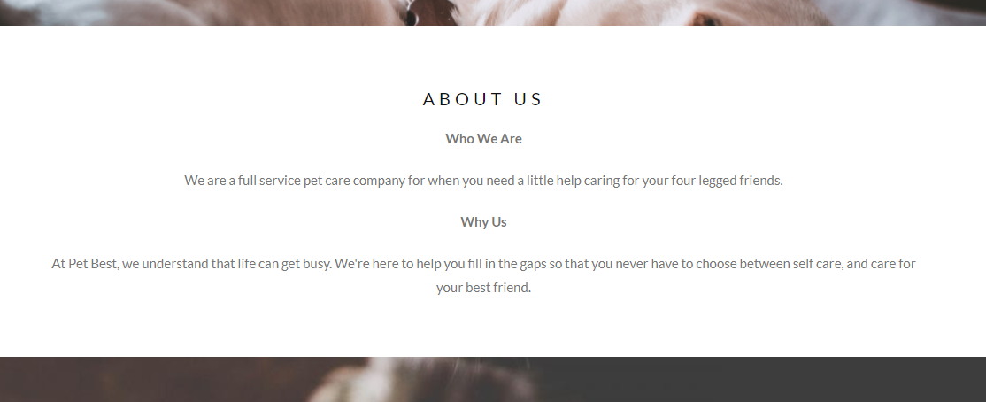
About Us Page

Slide 7
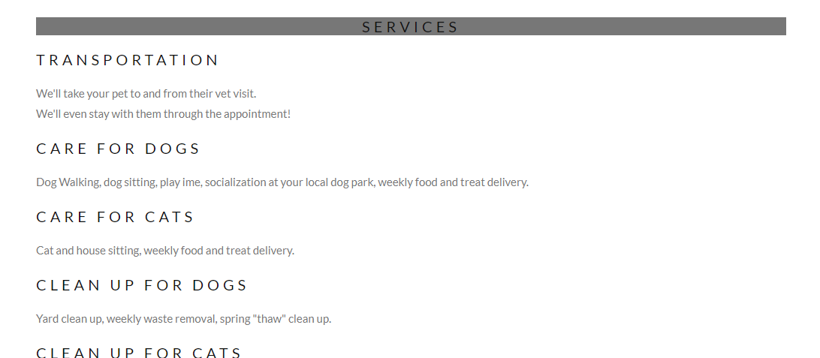
About Us Continued...

Slide 8
What's next for Front End
We plan to use more animations using JavaScript and CSS to allow for a smoother feel of the website
Add more information about the company itself and the owner to make a more meaningful Home and About Us page
Subscription page with prices the users can purchase

Slide 9






App-Dev
Hakim
Lauren
Ahmad
Ali
Abad
Hishaam

Slide 10
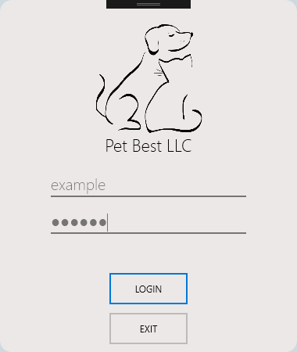
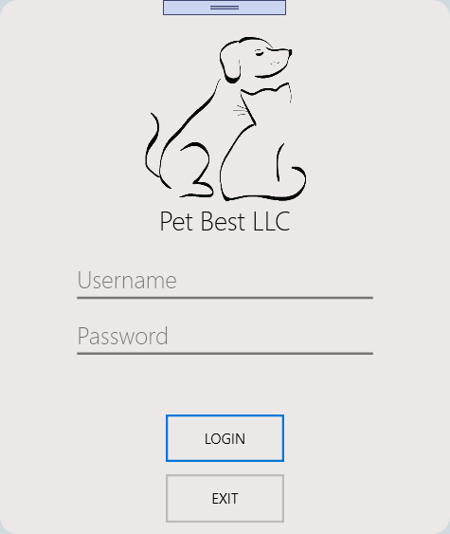
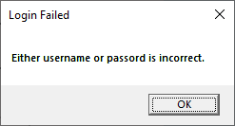
Login
Application exclusively for Admin and Employee

Slide 11
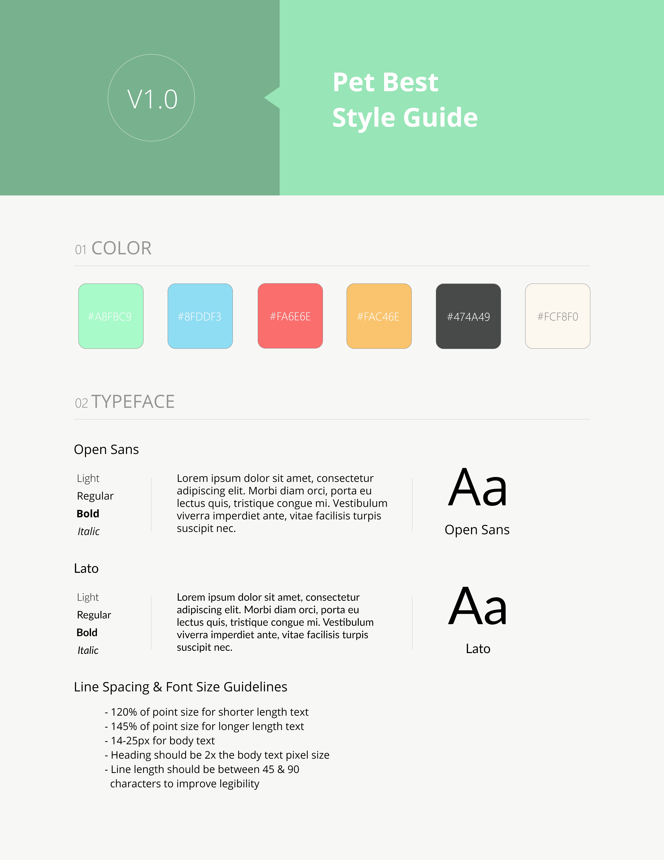
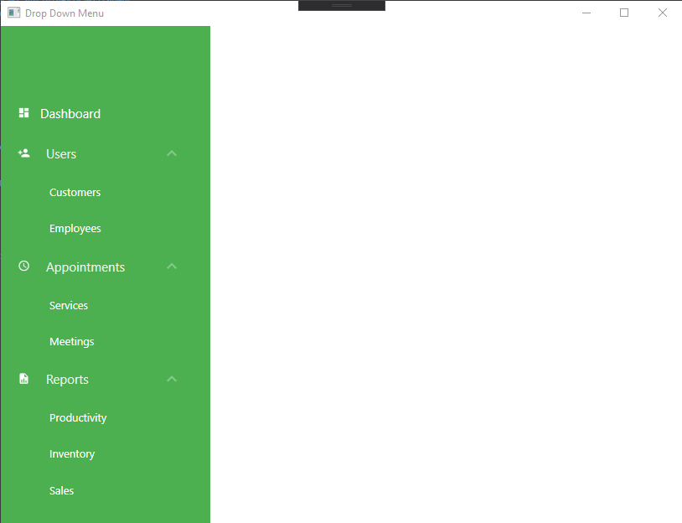
Design
Windows Presentation Foundation (WPF)
Style Guide

Slide 12
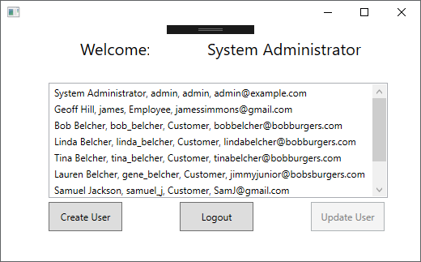
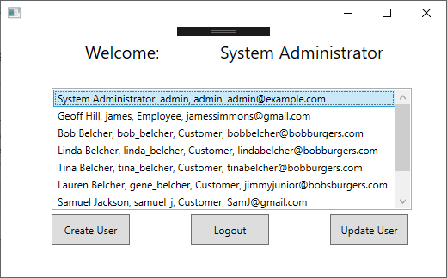
Main Window
Different forms for different users
Users perform actions from here

Slide 13
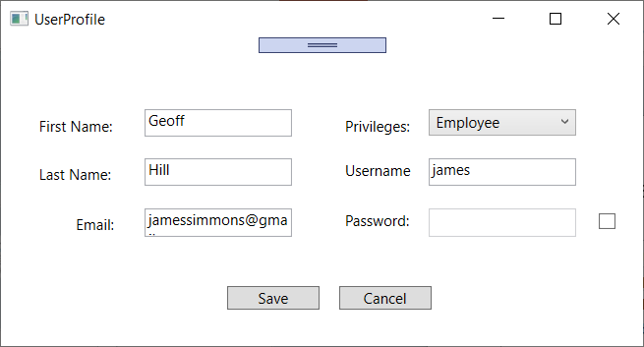
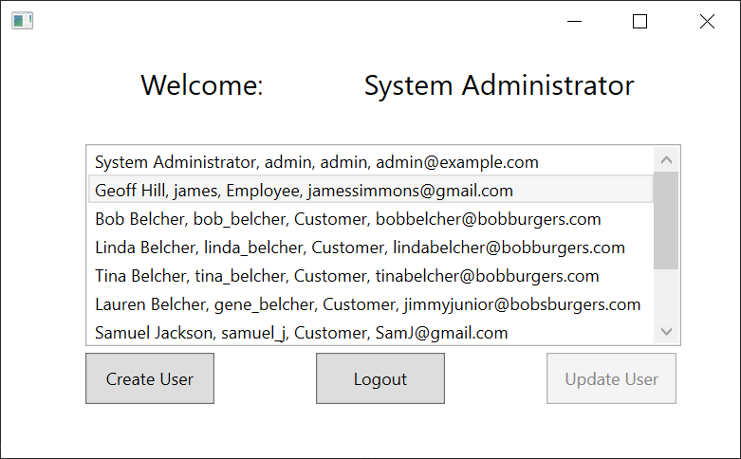
Update User Form
Ability to choose an account and update profile
All fields are displayed, simply update and save changes

Slide 14
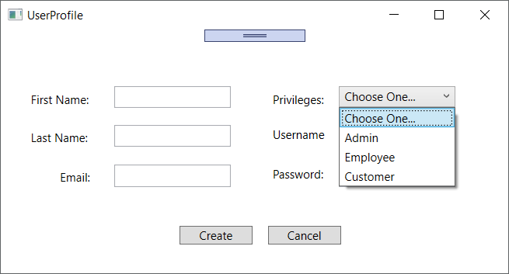
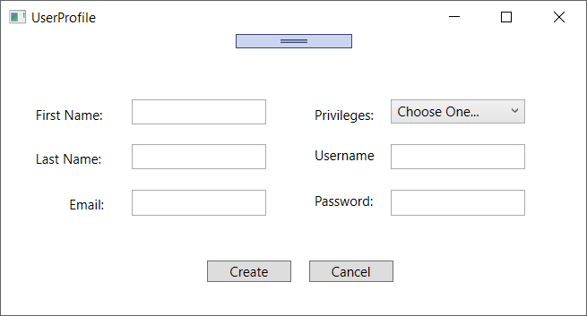
Create User Form
Same User Profile form as Update User
Required fields include password and privileges

Slide 15
API Communication
Send request to REST API
REST API recives request
REST API sends data back as JSON
Program catches JSON values and decrypts them
Program stores values in an object to be used
API (Application Programming Interface)
REST API
JSON

Slide 16
Asynchronous Programming
A
B
C
D
Synchronous:
A
B
Asynchronous:
C
D
Multiple processes running at once
More control over UI

Slide 17


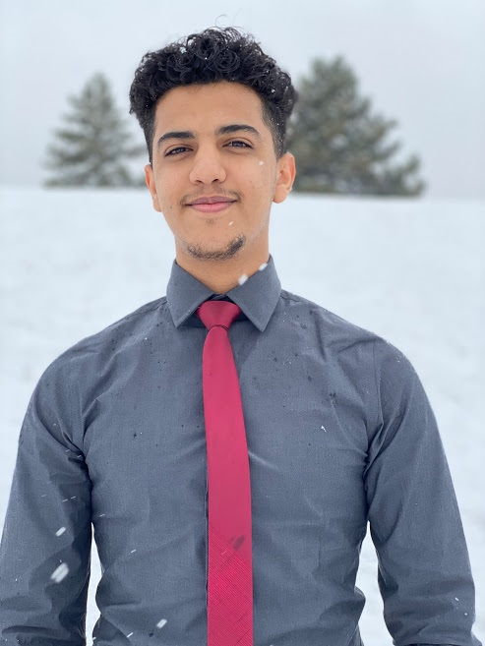

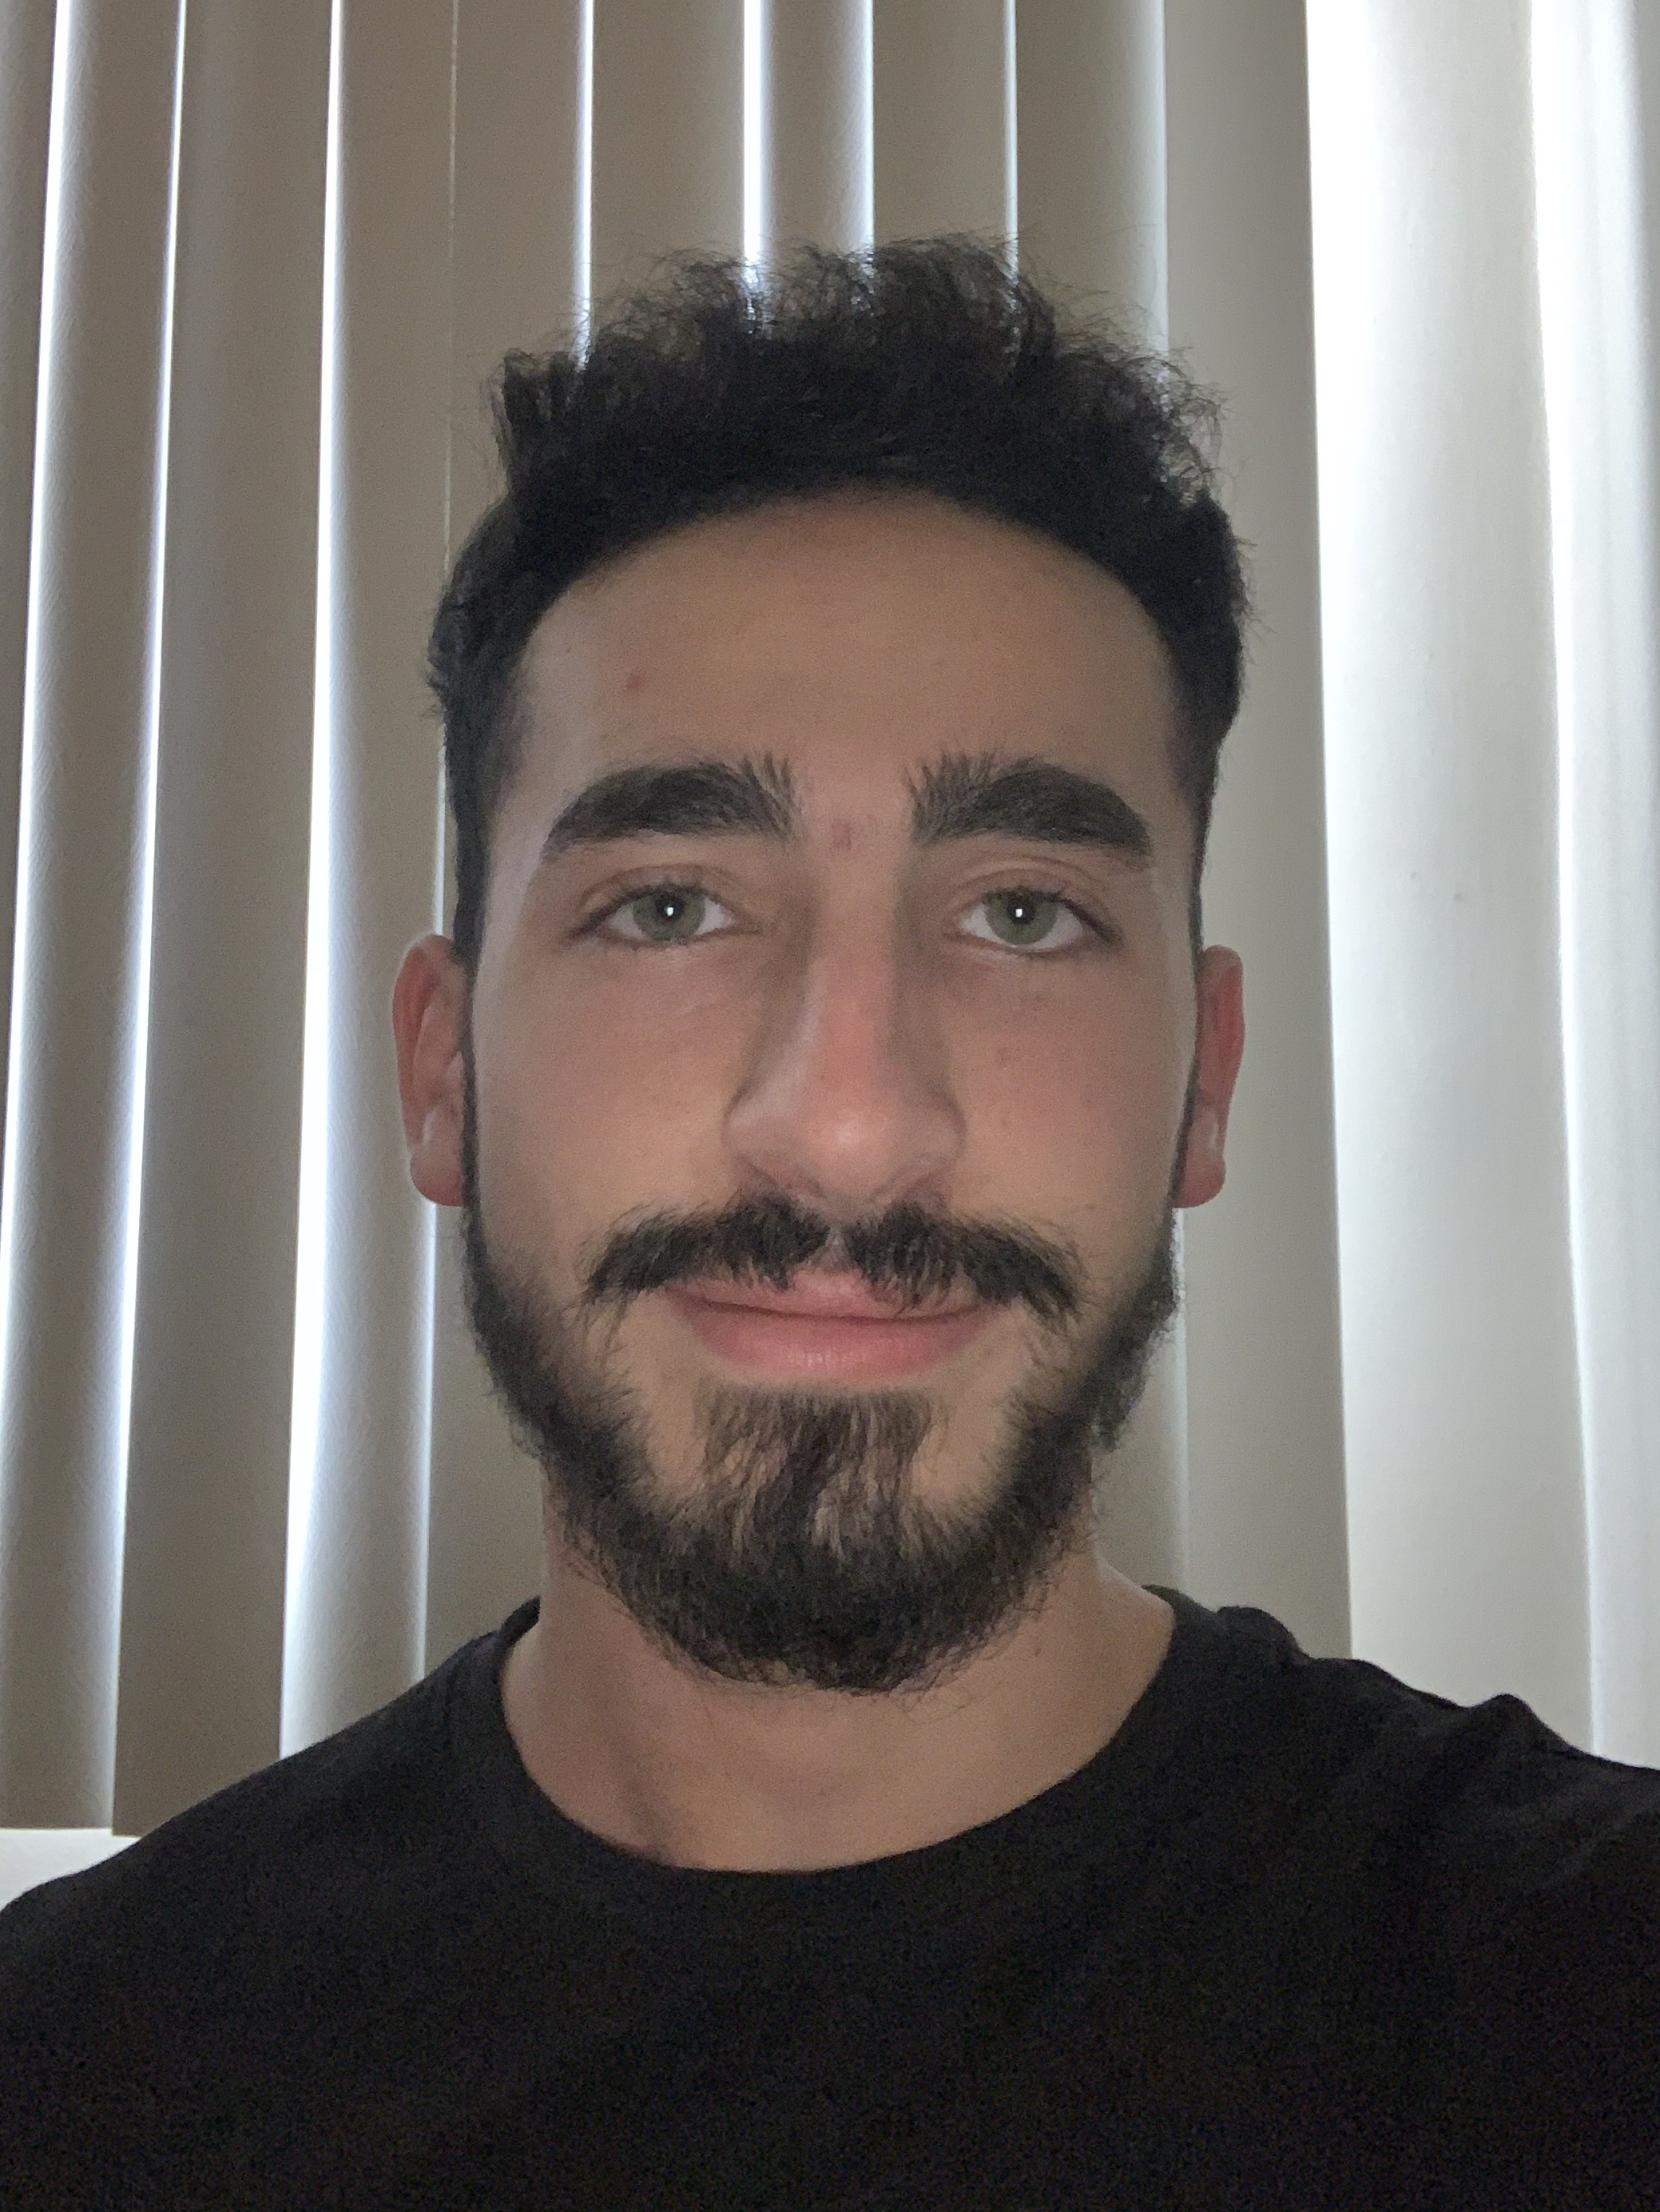
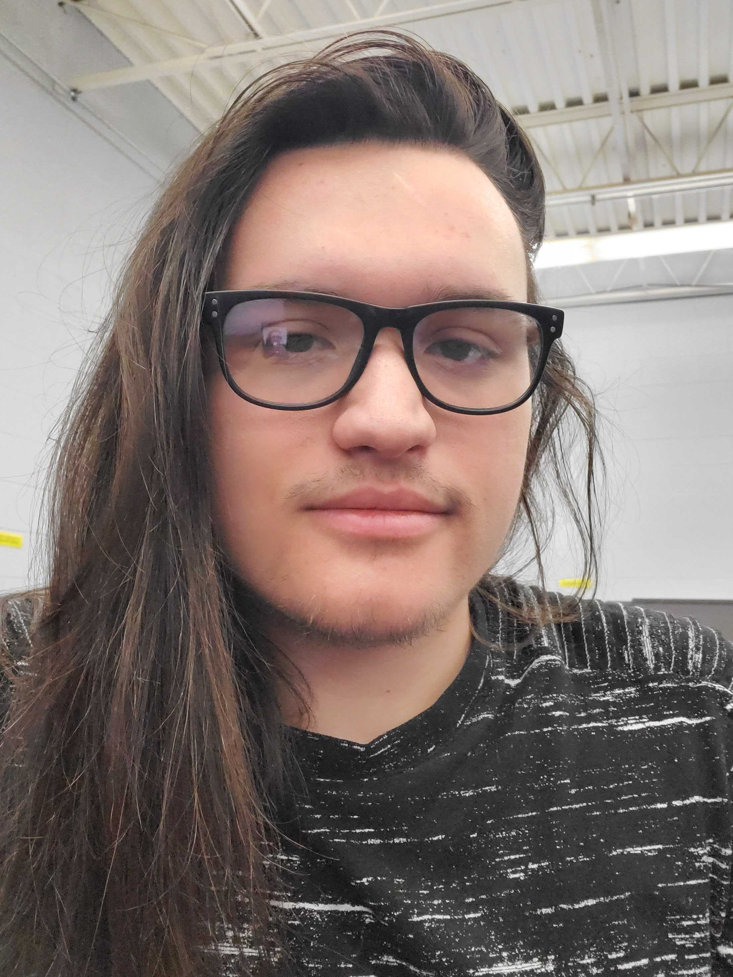
Introduction
The BackEnd team mission is to give each team a way to access the database and perform key tasks essential to Pet Best IT Solution.
Team Lead
#4
Brian
Murad
Aldura
Wedad
#6
Fouad
Alex

Slide 18
Services
Services implemented by BackEnd team:
Login Service
Create User Service
Update User
Service
Get Users
Service
Each service is usable by the website, as well as the desktop application.

Slide 19
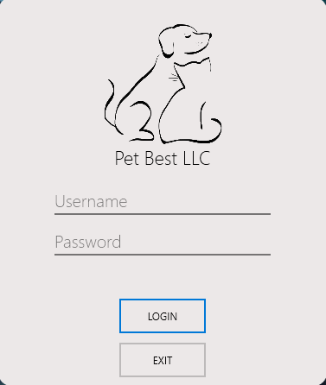
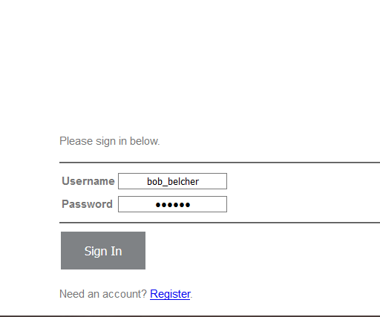
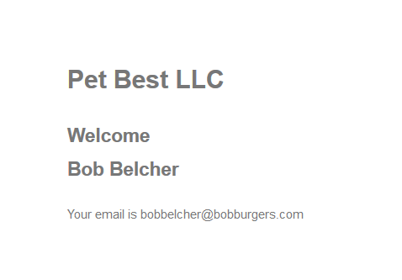
Login Service
Login page connects to database login service, giving access to user account.
Created logout page to allow users to securely log out.

Slide 20
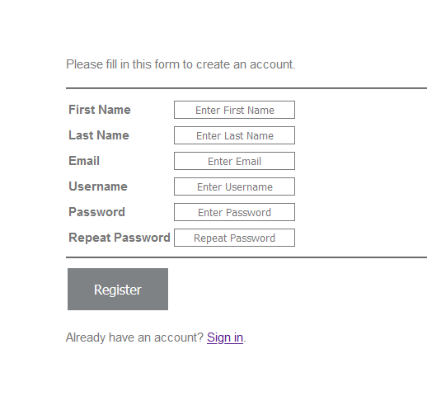
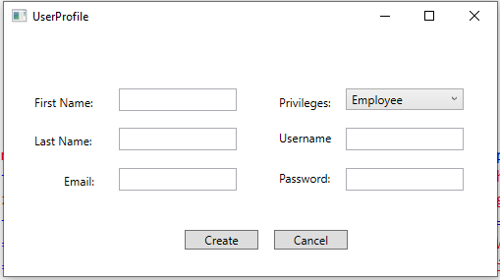
Create User Service
Registration forms connect to create user service created by BackEnd team.
Each application can use the service created by the BackEnd team.

Slide 21
Update User Service
Service will allow users to update information within their personal account.
Works dynamically with any information they want to update.
Get Users Service
Allows owner to request all or a single customers general information based on filters the owner chooses to use.

Slide 22
What's next for BackEnd?
Account page for the customer to view their past requests, and their account information.
Increase validation on forms to increase security for the website

Slide 23


Server Introduction
The Server team mission is to allow for all teams to develop and collaborate on each component of the Pet Best IT Solution seamlessly and efficiently.
Emad
El-Ali

Slide 24
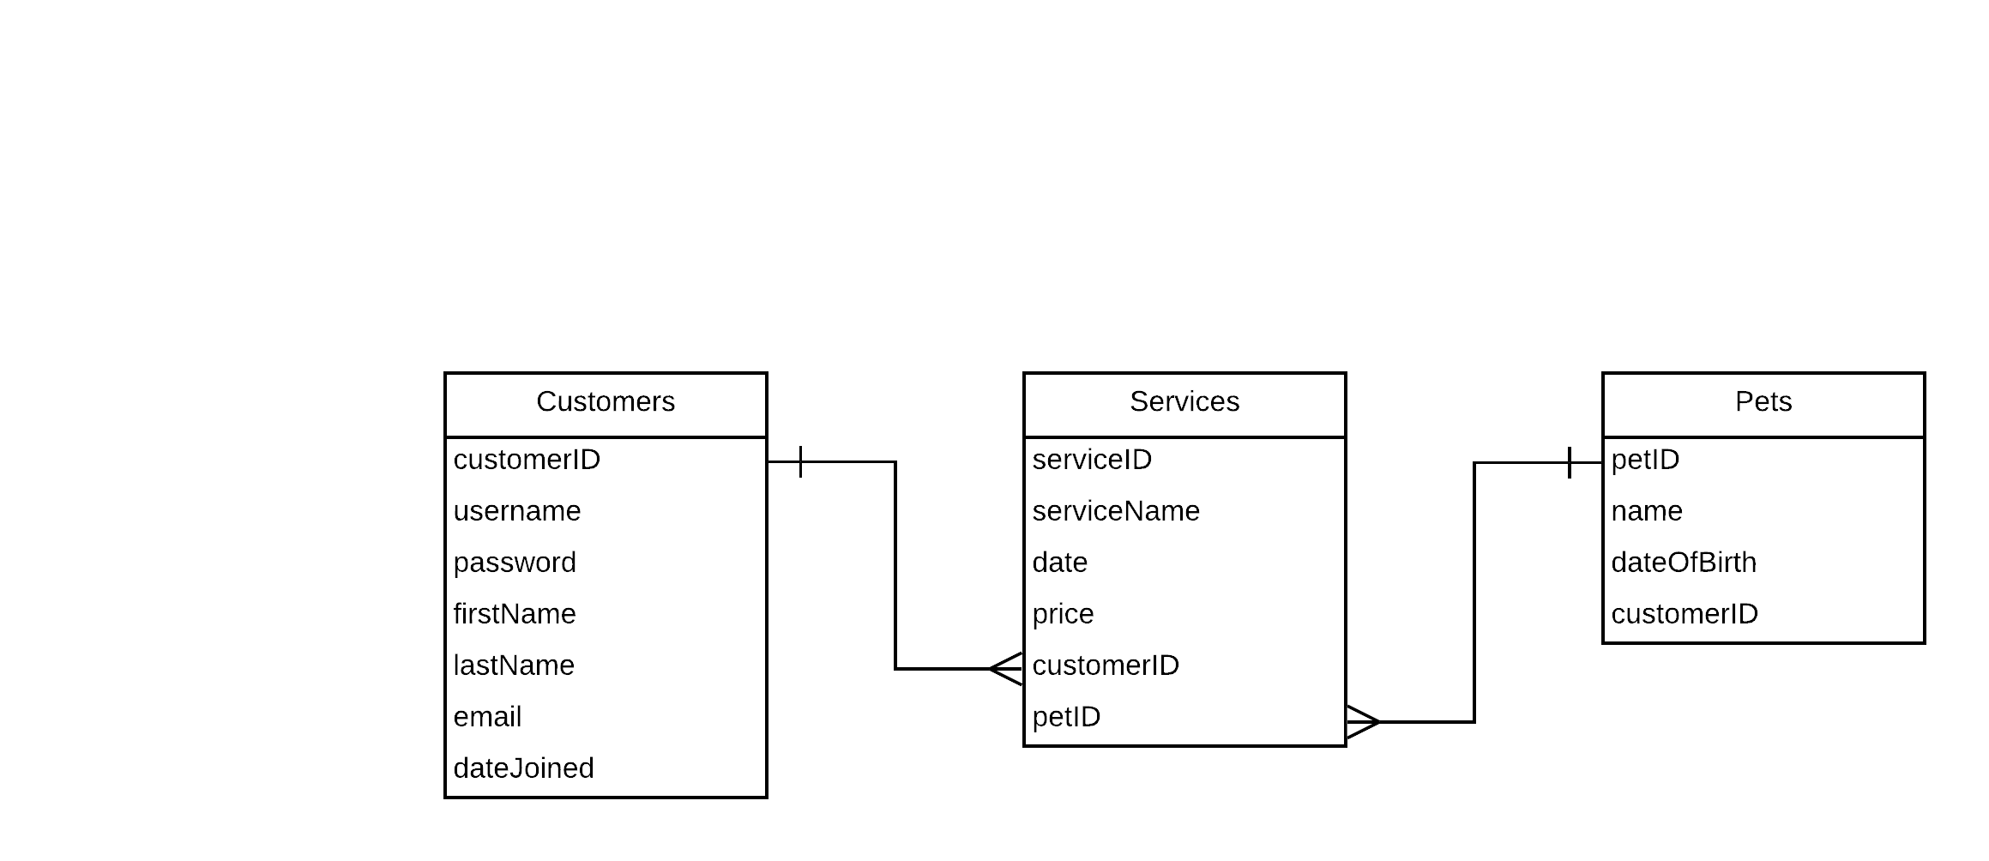
Server Set-Up
Server Hardware
CentOS 8
Apache
MariaDB
RDBMS
PHP Support

Slide 25
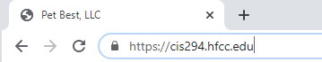
Website
HTTP
HTTPS
Automatic Website Updates
phpMyAdmin

Slide 26

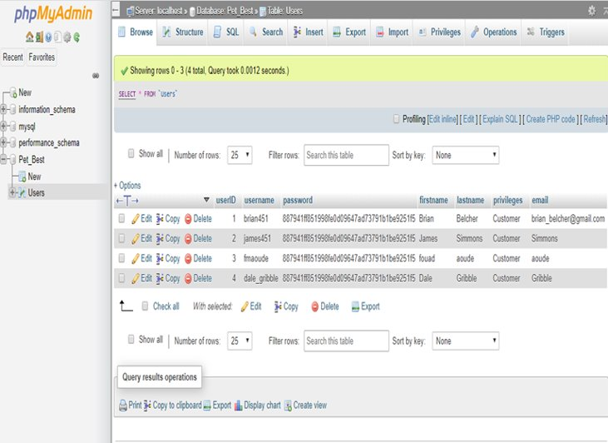
Pet Best Database

Slide 27

ROOT
WEBTEAM
Created for website files and deployment.
MAILTO
Scripts that manage the website's code should not run as root.
Webhook only works on GITLAB server, will create a temp file.
Created after adding cron entry to run script once per minute. Also, set to deliver mails from the repository to a log file.
Webhook_cron.php will allow to process webhook.
Virtual Host
VirtualHost configurations to redirect traffic to https.
Configured to specify Server Name: cis294.hfcc.edu
BackEnd
FrontEnd
Apache Server
AppDev

Slide 28
Server
Next steps include:
Backing up server and user configuration files
Readily available database files
Completing the rest of the database structure

